Slide 1
Deep Reinforcement Learning in Ice Hockey for Context-Aware Values and Player Evaluation
Oliver Schulte, Guiliang Liu
2018/02/23

Slide 2
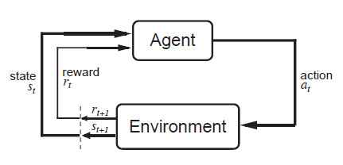
Reinforcement Learning
Basic Model
(1) In state s1, do action a1, get reward r1 and next state s2
(2)Transition (s1, a1, r1, s2)
s1
a1
r1
s2
a2
r2
s3
2/26

Slide 3
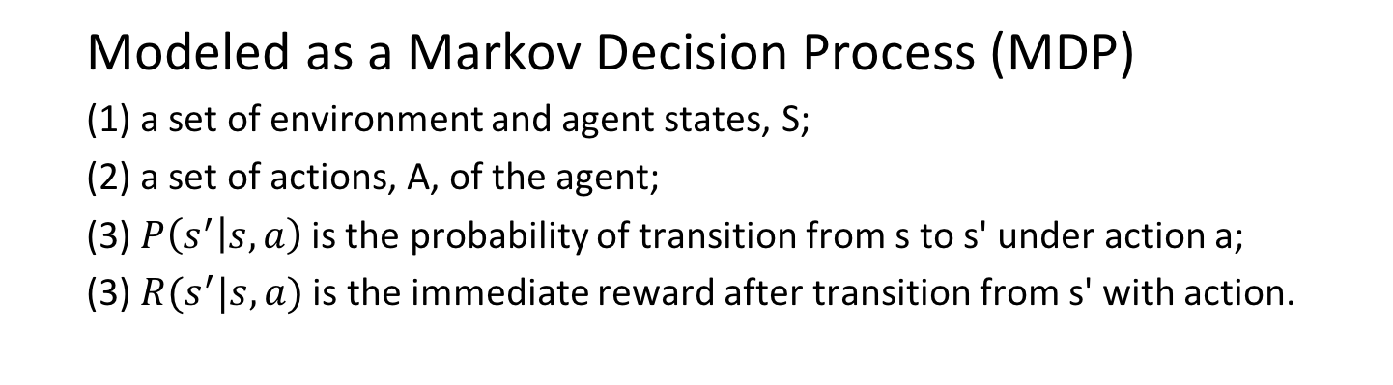
Reinforcement Learning
Modeled as a Markov Decision Process (MDP)
(1) a set of environment and agent states, S;
(2) a set of actions, A, of the agent;
(3) $P\left(s^{′} | s,a\right)$is the probability of transition from s to s' under action a;
(3) $R(s^{′}|s,a)$ is the immediate reward after transition from s' with action.
3/26

Slide 4
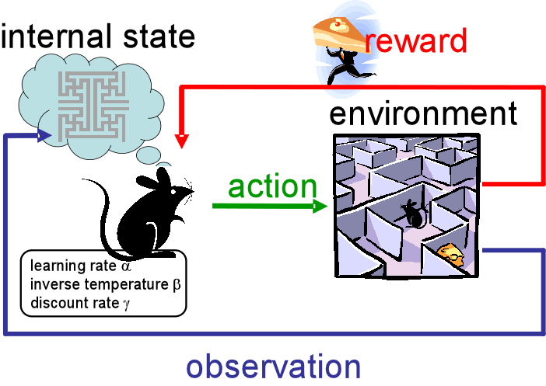
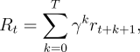
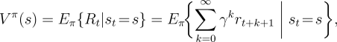
Reinforcement Learning
Terminology
(1) A policy:
(2) Discount rate:
(3) Discount reward at state t:
(4) Value function:
(5) Q-function:
Π
Υ
Notes:
this is dense

Slide 5
RL Concepts
These 3 functions can be computed by neural networks

Slide 6
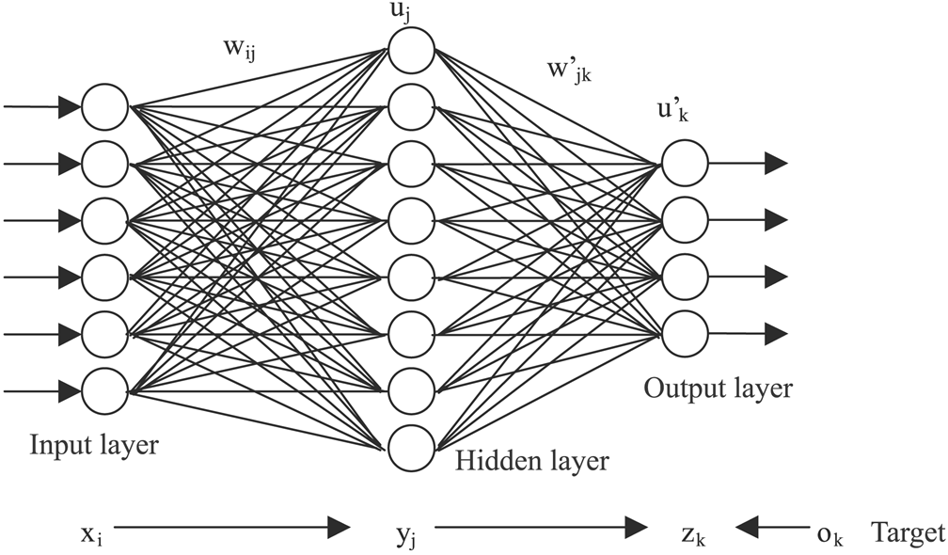





Deep Reinforcement Learning
Function Approximate:
(1) Normally,we use a table to record the V(s) and Q(s, a)
(2) But we can apply Neural Network to learn V-function and Q-function
State | Action | V(s) | Q(s, a)
S1 | A1 | 0.345 | 0.012
V(S1)
S1
Q(S1, A1)

Slide 7
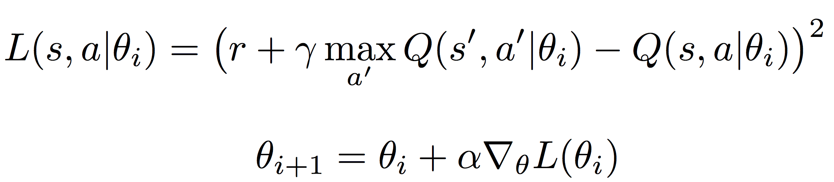
Deep Reinforcement Learning
Apply Gradient-Descent Methods to modify parameter θ
(1) Loss function: Mean Square Error
(2) Deep Reinforcement Learning (DRL) structure
Notes:
intuition

Slide 8
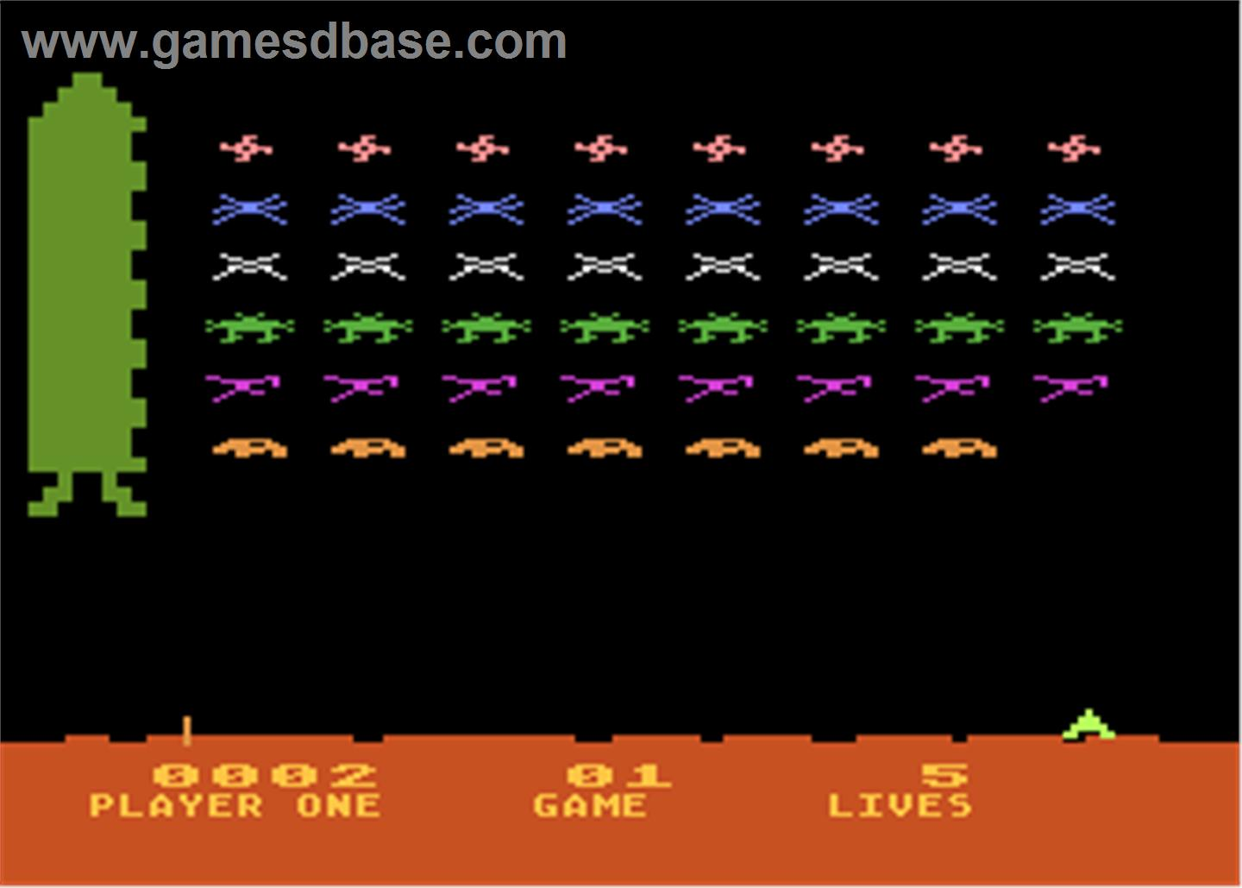
Deep Reinforcement Learning
Application of Deep Reinforcement Learning
(1) Play Video game
E.g. Atari game and Doom
[1] Volodymyr Mnih, et al. Human-level control through deep reinforcement learning. Nature, 518(7540):529–533, 2015.

Slide 9
Deep Reinforcement Learning
Application of Deep Reinforcement Learning
(1) Self-Driving Car
But mostly in simulated environment

Slide 10
Deep Reinforcement Learning
Application of Deep Reinforcement Learning
(1) Sport analytic
In Professional Sports Game, E.g. Ice Hockey

Slide 11
What we want to do?
Sport analysis for Ice Hockey：
1.Evaluate the action.
(1) Which action is likely to lead to the next goal?
Can be answered using Q(match state, action)
(2) How an action changes the chance of scoring
Can be answered using a novel impact concept
2. Evaluate the player.
(1) Which player is most efficient in the match?
(2) Which player is underestimated or overestimated
Notes:
add Q-functin

Slide 12
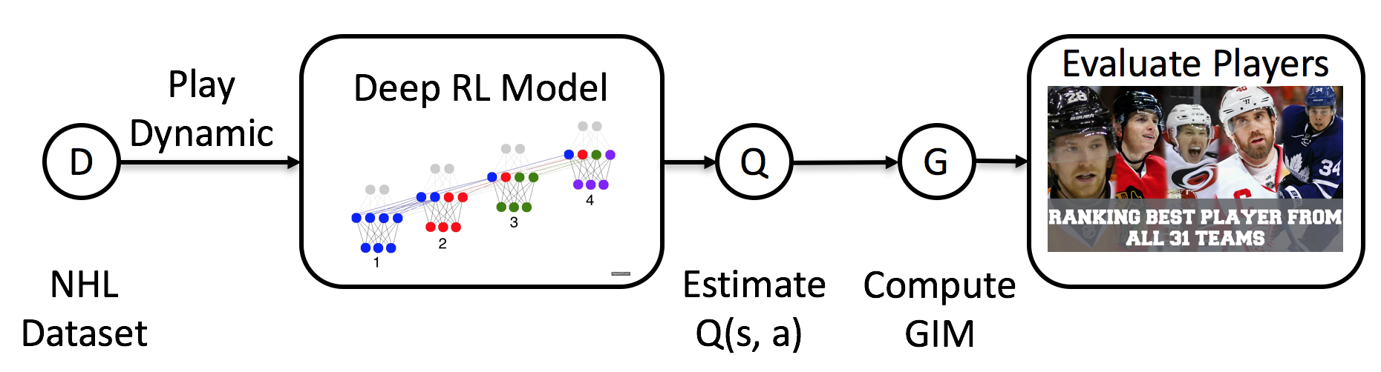
Problem Formulation
1. We apply Reinforcement Learning to estimate the Q(s, a) from game data
2. We define a new player evaluation metric called Goal Impact Metric (GIM) to value each player

Slide 13
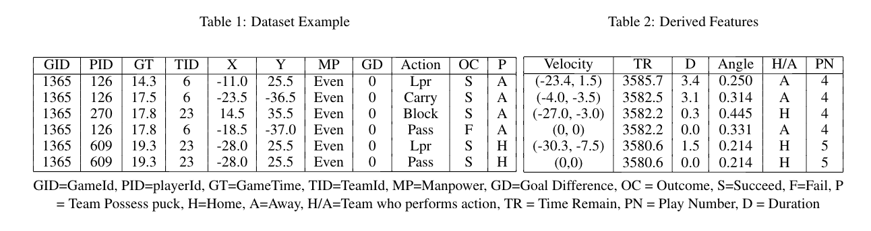
Dataset
play-by-play events in the NHL
(1) We utilize a dataset constructed by SPORTLOGiQ using computer vision techniques.
(2) The data provide information about game events and player actions for the entire 2015-2016 NHL season,
(3) It cover which contains 3,382,129 events, covering 30 teams, 1140 games and 2,233 players.

Slide 14
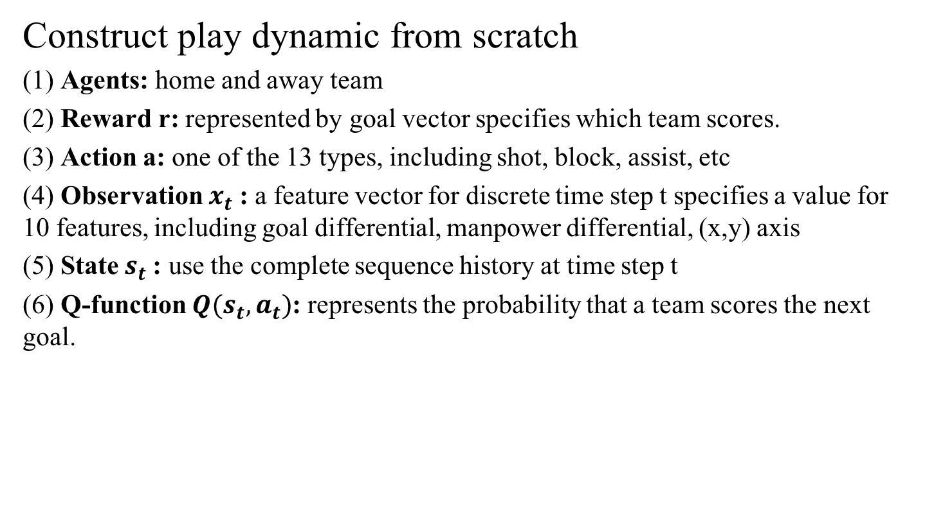
Play Dynamic in NHL
Construct play dynamic from scratch
(1) Agents: home and away team
(2) Reward r: represented by goal vector specifies which team scores.
(3) Action a: one of the 13 types, including shot, block, assist, etc
(4) Observation $x_{t}$: a feature vector for discrete time step t specifies a value for 10 features, including goal differential, manpower differential, (x,y) axis
(5) State $s_{t}$: use the complete sequence history at time step t
(6) Q-function $Q(s_{t},a_{t})$: represents the probability that a team scores the next goal.

Slide 15
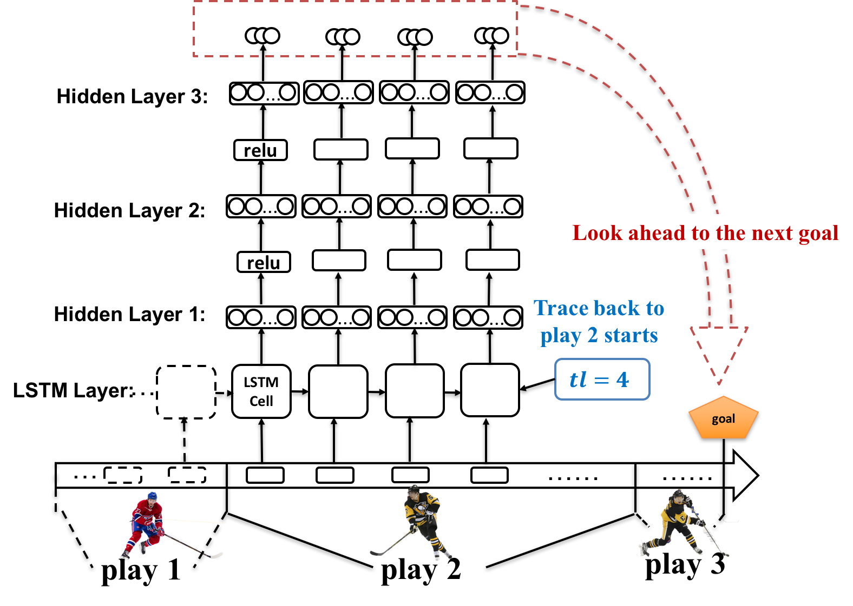
Model Structure
Deep Recurrent Q Neural Network with dynamic trace length

Slide 16
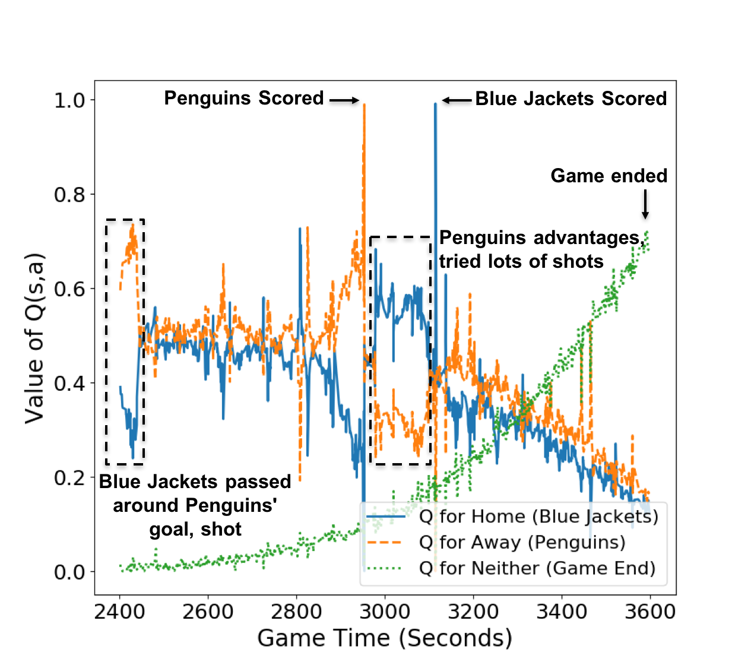
Temporal Projection
Deep Recurrent Q Neural Network with dynamic trace length
Notes:
value ticker

Slide 17
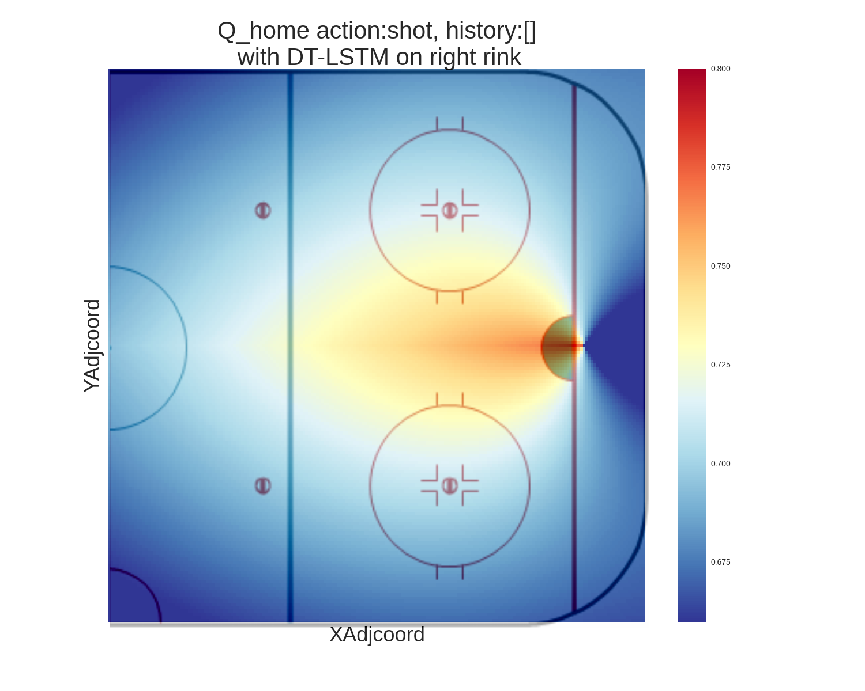
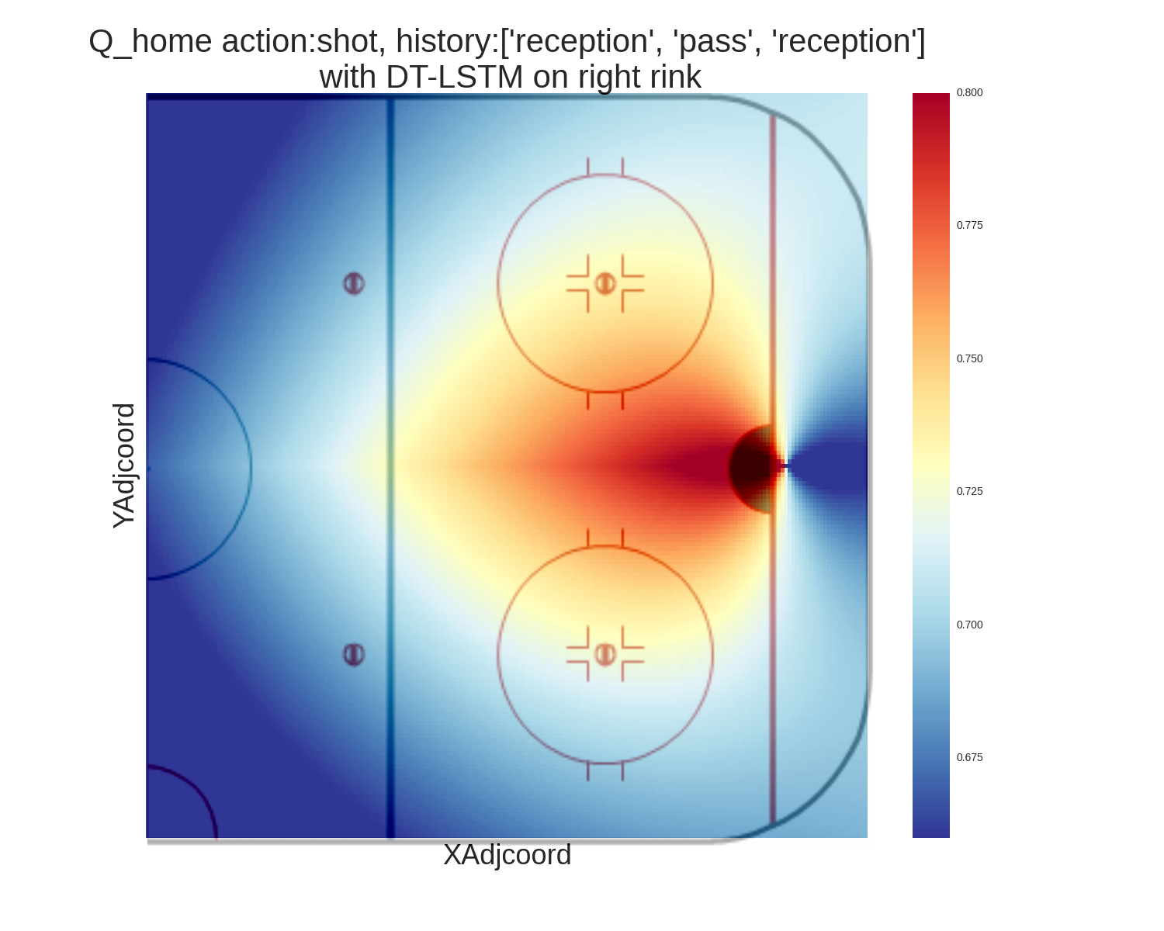
Spatial Projection
Deep Recurrent Q Neural Network with dynamic trace length
(1) Trace length = 0 (2) Trace length = 3

Slide 18
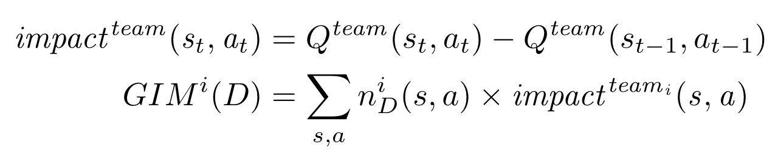
Goal Impact Metric (GIM)
1. Measure the quality of an action by how much it changes the expected return of a player's team.
2. Compute impact: the change in Q-value due to a player‘s action (The difference between successive points in the Q-value ticker).
3. The total impact of a player's actions is his GIM

Slide 19
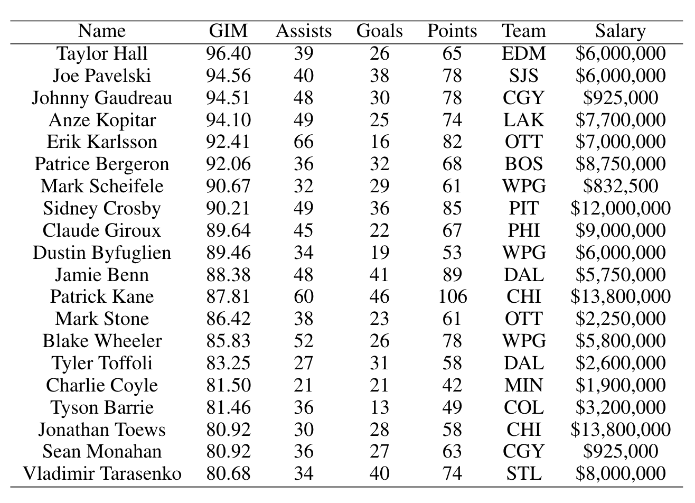
Player Ranking
Top-20 highest impacts players
Identify undervalued players
Johnny Gaudreau and Mark Scheifele drew salaries below what their GIM rank would suggest. Later they received a $5M+ contract for the 2016-17 season.

Slide 20
Empirical Evaluation
Comparison Metric
1. Plus-Minus (+/-): a commonly used metric that measures how the presence of a player influences the goals of his team.
2. Goal-Above-Replacement (GAR): estimates the difference of team‘s scoring chances when the target player plays, vs. replacing him with an average player.
3. Win-Above-Replacement (WAR): similar to GAR but for winning chances.
4. Expected Goal (EG): weights each shot by the chance of it leading to a goal
5. Scoring Impact (SI): is the most similar method to GIM based on Q-values. But it is learned with pre-discretized spatial regions and game time
5. GIM-T1: similar to GIM but set trace length of LSTM to 1

Slide 21
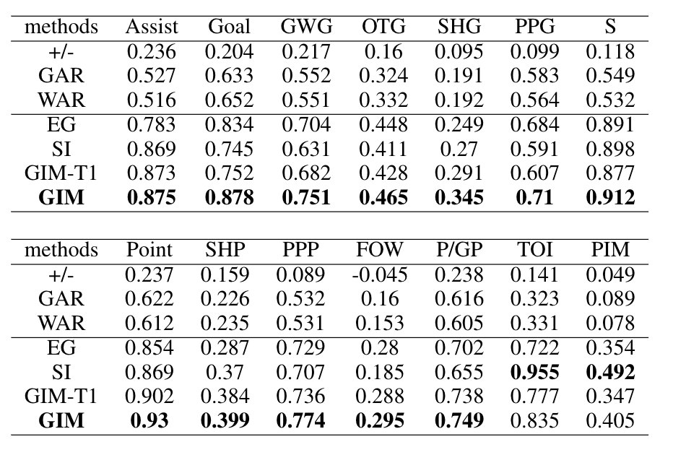
Empirical Evaluation
1. Correlations with standard Success Measures:
Compute the correlation coefficients of the metric with 14 standard success measures:

Slide 22
Empirical Evaluation
2. Round-by-Round Correlations:
(1) A sports season is commonly divided into rounds. In round n, a team or player has finished n games in a season.
(2) For a given performance metric, we measure the correlation between
(i) its value computed over the first n rounds
(ii) the value of the three main success measures, assists, goals, and points, computed over the entire season.
(3) To assess how quickly different metrics acquire predictive power for the final season total, so that future performance can be predicted from past performance.

Slide 23
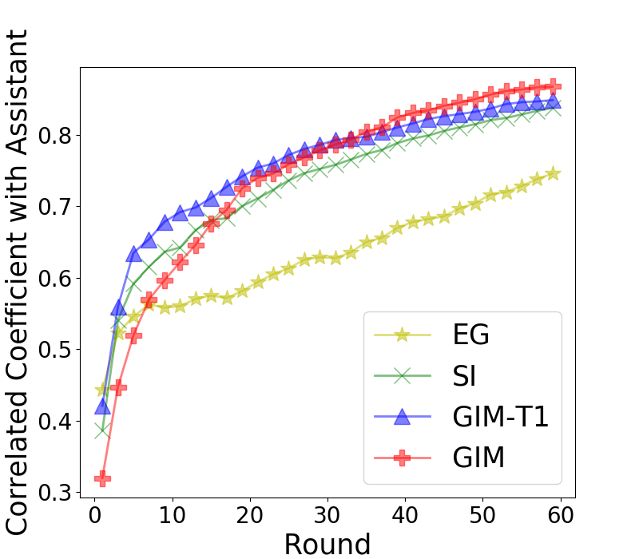
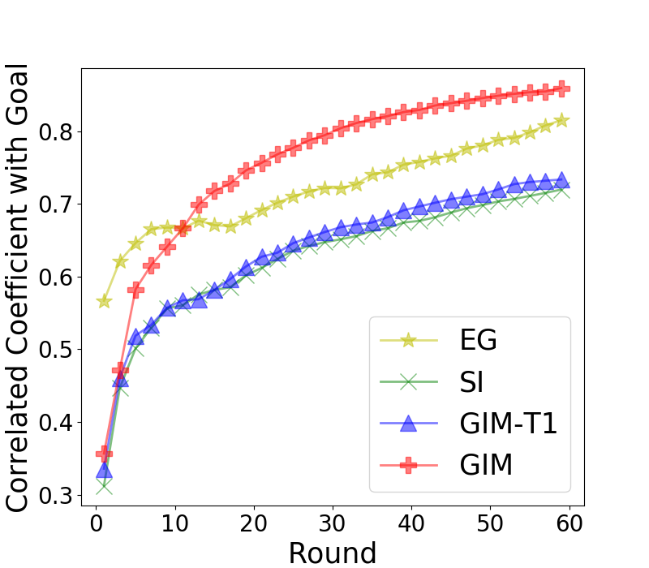
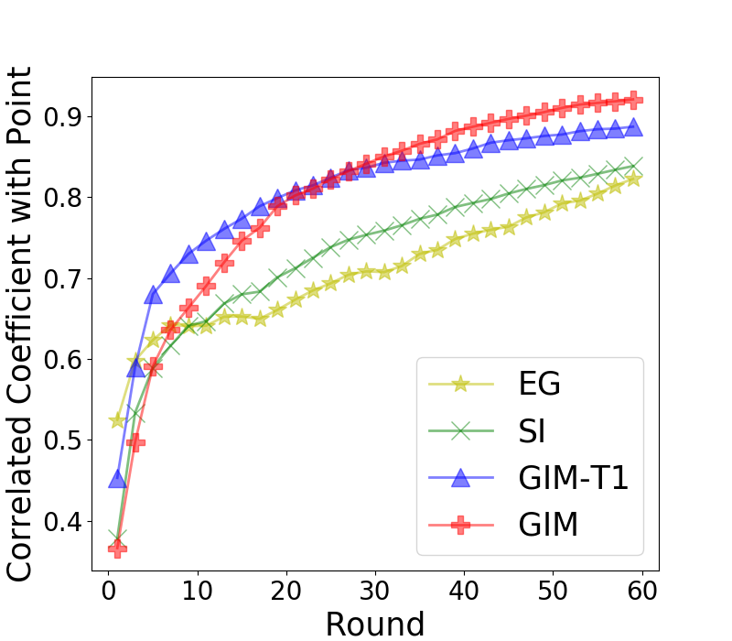
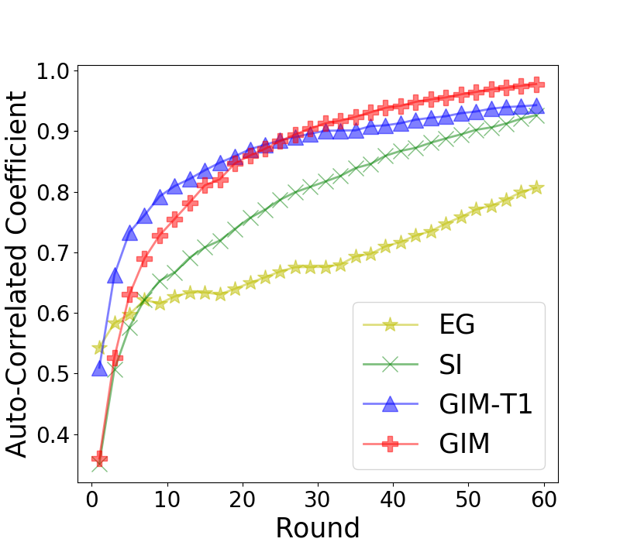
Empirical Evaluation
Round-by-Round Correlations:
(a)Assist
(b) Goal
(c) Point
(d) Auto

Slide 24
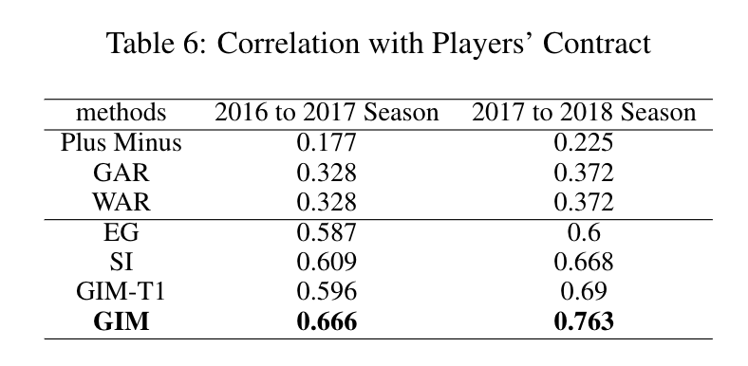
Empirical Evaluation
3. Predicting Players' Salary
(1) A good performance metric should be positively related to the amount of players' future contract.
(2) The NHL regulates when players can renegotiate their contracts, so we focus on players receiving a new contract following the 2015-2016 NHL season

Slide 25
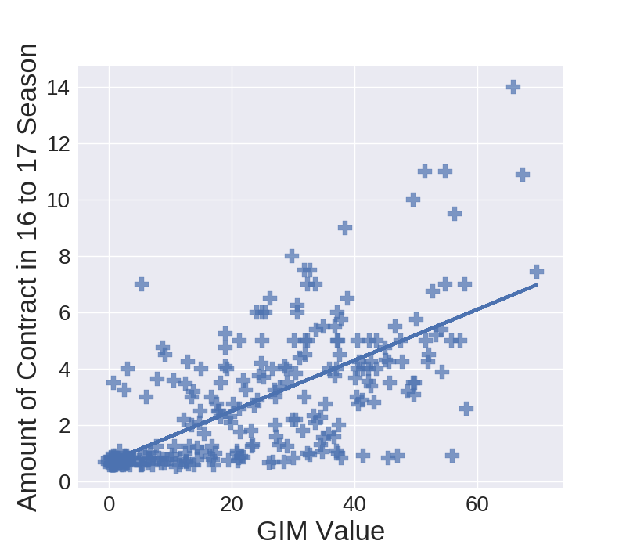
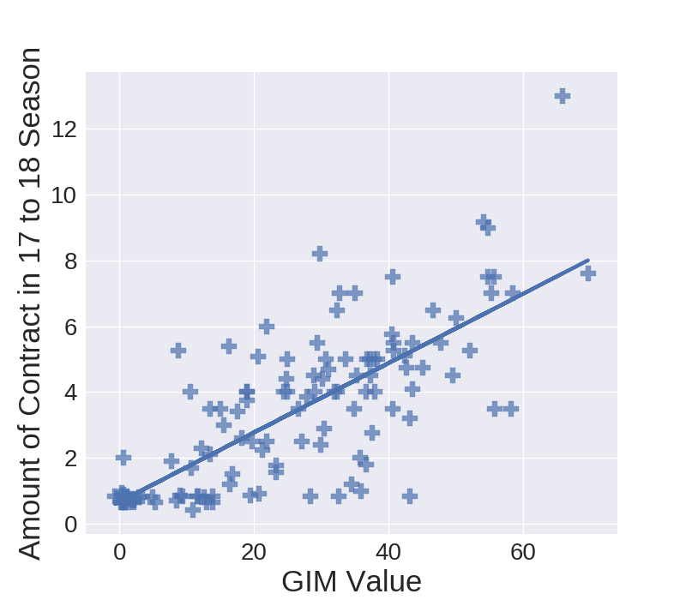
Empirical Evaluation
3. Predicting Players' Salary
(1) In the 2016-17 season (left), we find many underestimated players (with high GIM but low salary).
(2) But the percentage of players who are undervalued decreases in the next season.
(3) This suggests that GIM provides an early signal of a player's value.

Slide 26
Conclusion
1. We investigated Deep Reinforcement Learning (DRL) for professional sports analytics. We applied DRL to learn complex spatio-temporal NHL dynamics.
2. We developed an innovative context-aware performance metric GIM that provides a comprehensive evaluation of NHL players, taking into account all of their actions.
3. In our experiments, GIM had the highest correlation with most standard success measures, was the most temporally consistent metric, and generalized best to players' future salary.

Slide 27
Questions and Comments?
Thank you!

